Slide 1

BIG DATA PROJECT ANT COMPANY – RISK ANALYSIS
GROUP 9:
DEV JOSHI
AYMAN SIDDIQ RAZA
SHUBHANGI GAUR
INDRAJEET THAKARE
SAI KIRAN

Slide 2
Contents
Overview
Objectives
Project Flow Chart
Relational Database
Analysis
Regression with R
Challenges and Conclusions

Slide 3
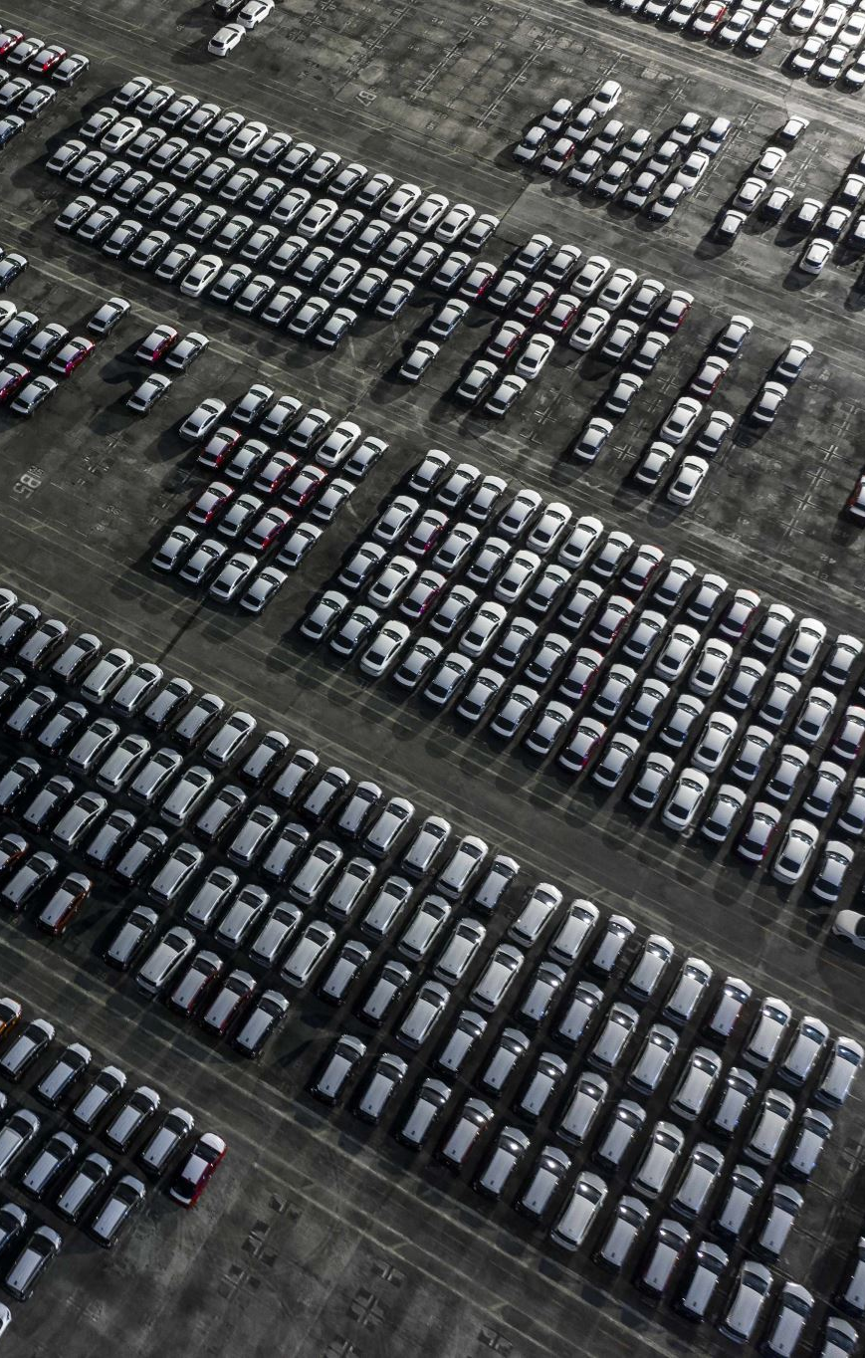
Overview
*The main goal of a large trucking firm with its headquarters in California is to supervise and guarantee adherence to all corporate driving rules.
*In order to minimize insurance losses resulting from non-compliance and to maintain the fleet's safety standards, this position is essential.
Key Responsibilities:
Regularly update the compliance protocols to align with the latest national and state transportation regulations.
Implement measures to reduce risks associated with speeding, unsafe following distances, improper lane changes, and other hazardous driving behaviors.
Monitor driver behavior and performance through advanced tracking and reporting systems to identify and address any deviations promptly

Slide 4
Objectives
- Identify the most hazardous commercial truck drivers
- The ultimate goal is to uphold the highest standards of fleet operation safety and efficiency.
- Thereby ensuring the well-being of drivers and reducing operational costs related to non-compliance and insurance.

Slide 5
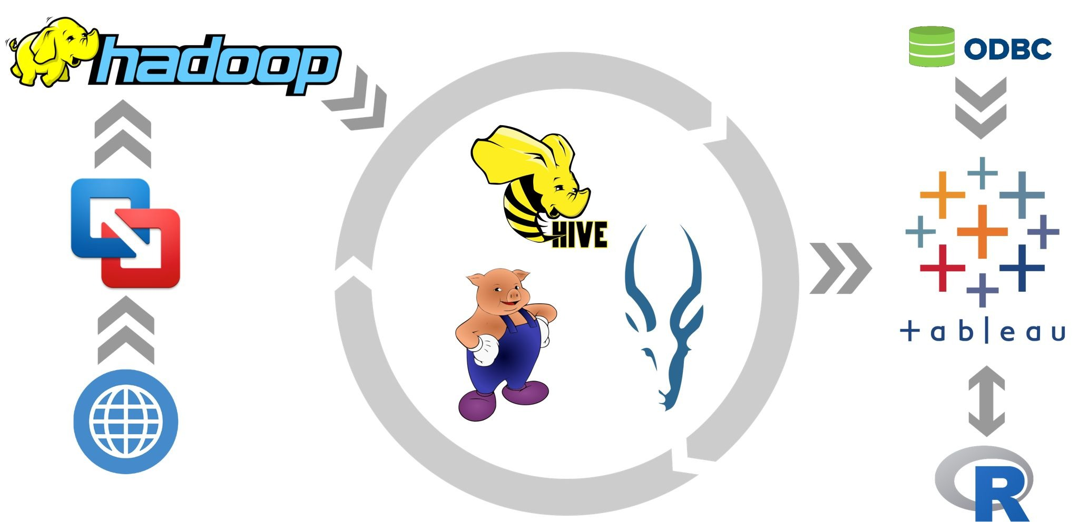
Project Flow Chart

Slide 6
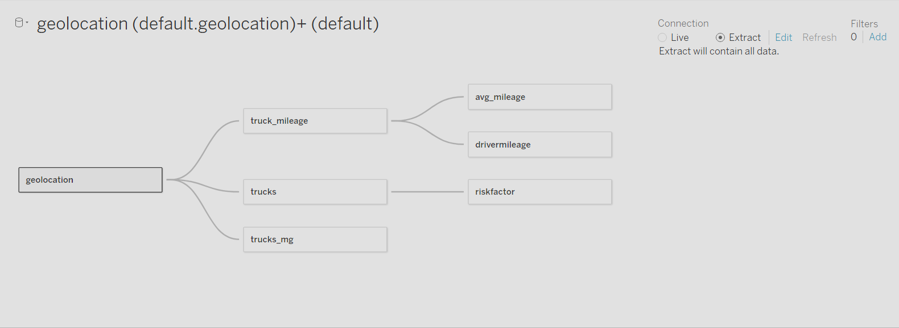
Relational Database
*Factors contributing the risk
*Miles Driven: Increased mileage equates to higher risk exposure and potential for wear-related vehicle issues.
*Speed: Excessive speed reduces reaction time, increases accident severity, and amplifies legal and safety concerns.
*Telematics Violations: Unsafe following, speeding, and lane departures recorded by sensors indicate critical risky behaviors.

Slide 7
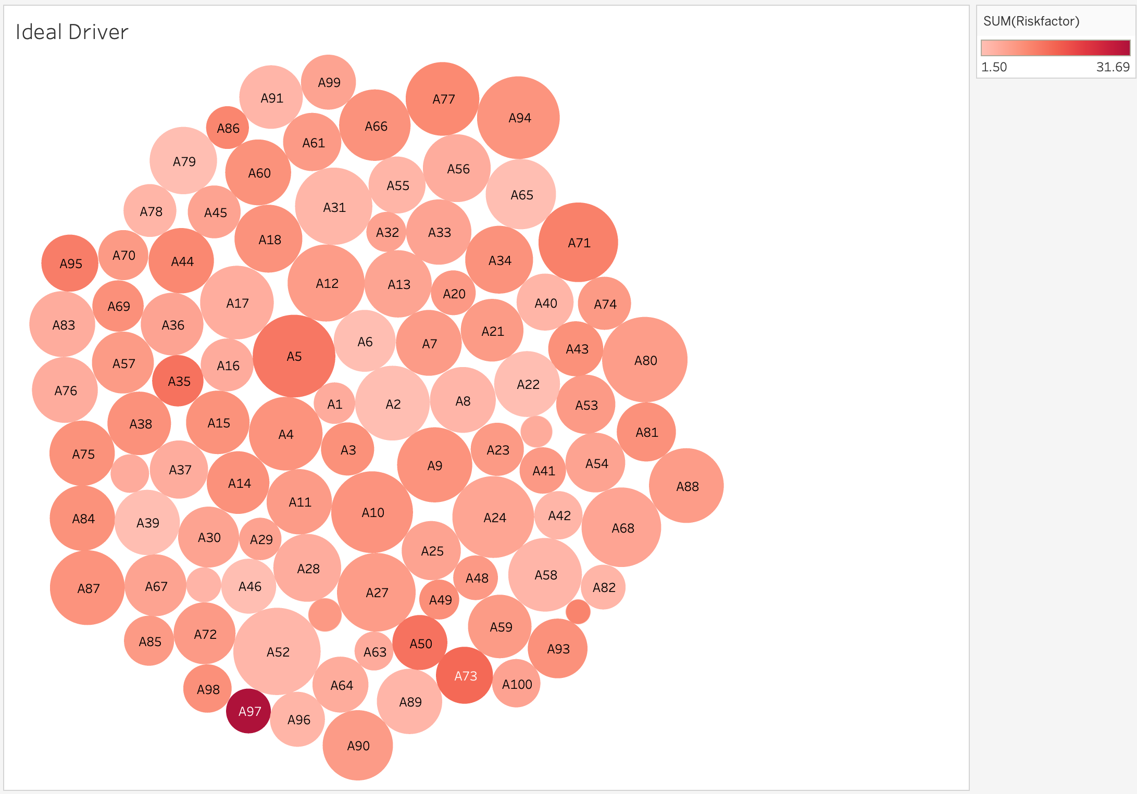
Analysis 1 – Ideal Driver
Who would be the ideal driver for the company?
*Bigger bubbles show drivers with more miles driven, suggesting experience.
*Lighter bubbles represent lower risk, indicating safety.
*The best drivers have big, light-colored bubbles, combining experience with safety.

Slide 8
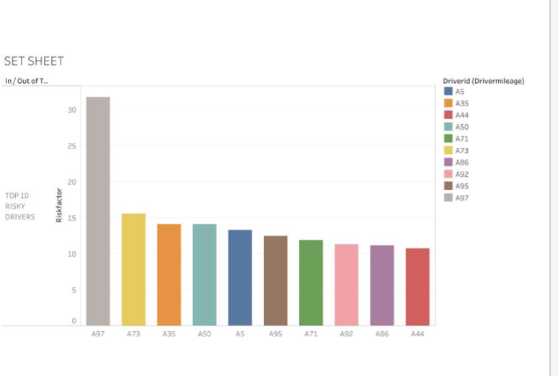
Analysis 2– Top 10 Risk Drivers
who are the top 10 riskiest drivers
*Driver A97 stands out as the riskiest with the highest risk factor.
*The next in line are Drivers A73, A35, A50, A5, A95, A71, A92, A86, and A44, listed in descending order of their risk factors.
\

Slide 9
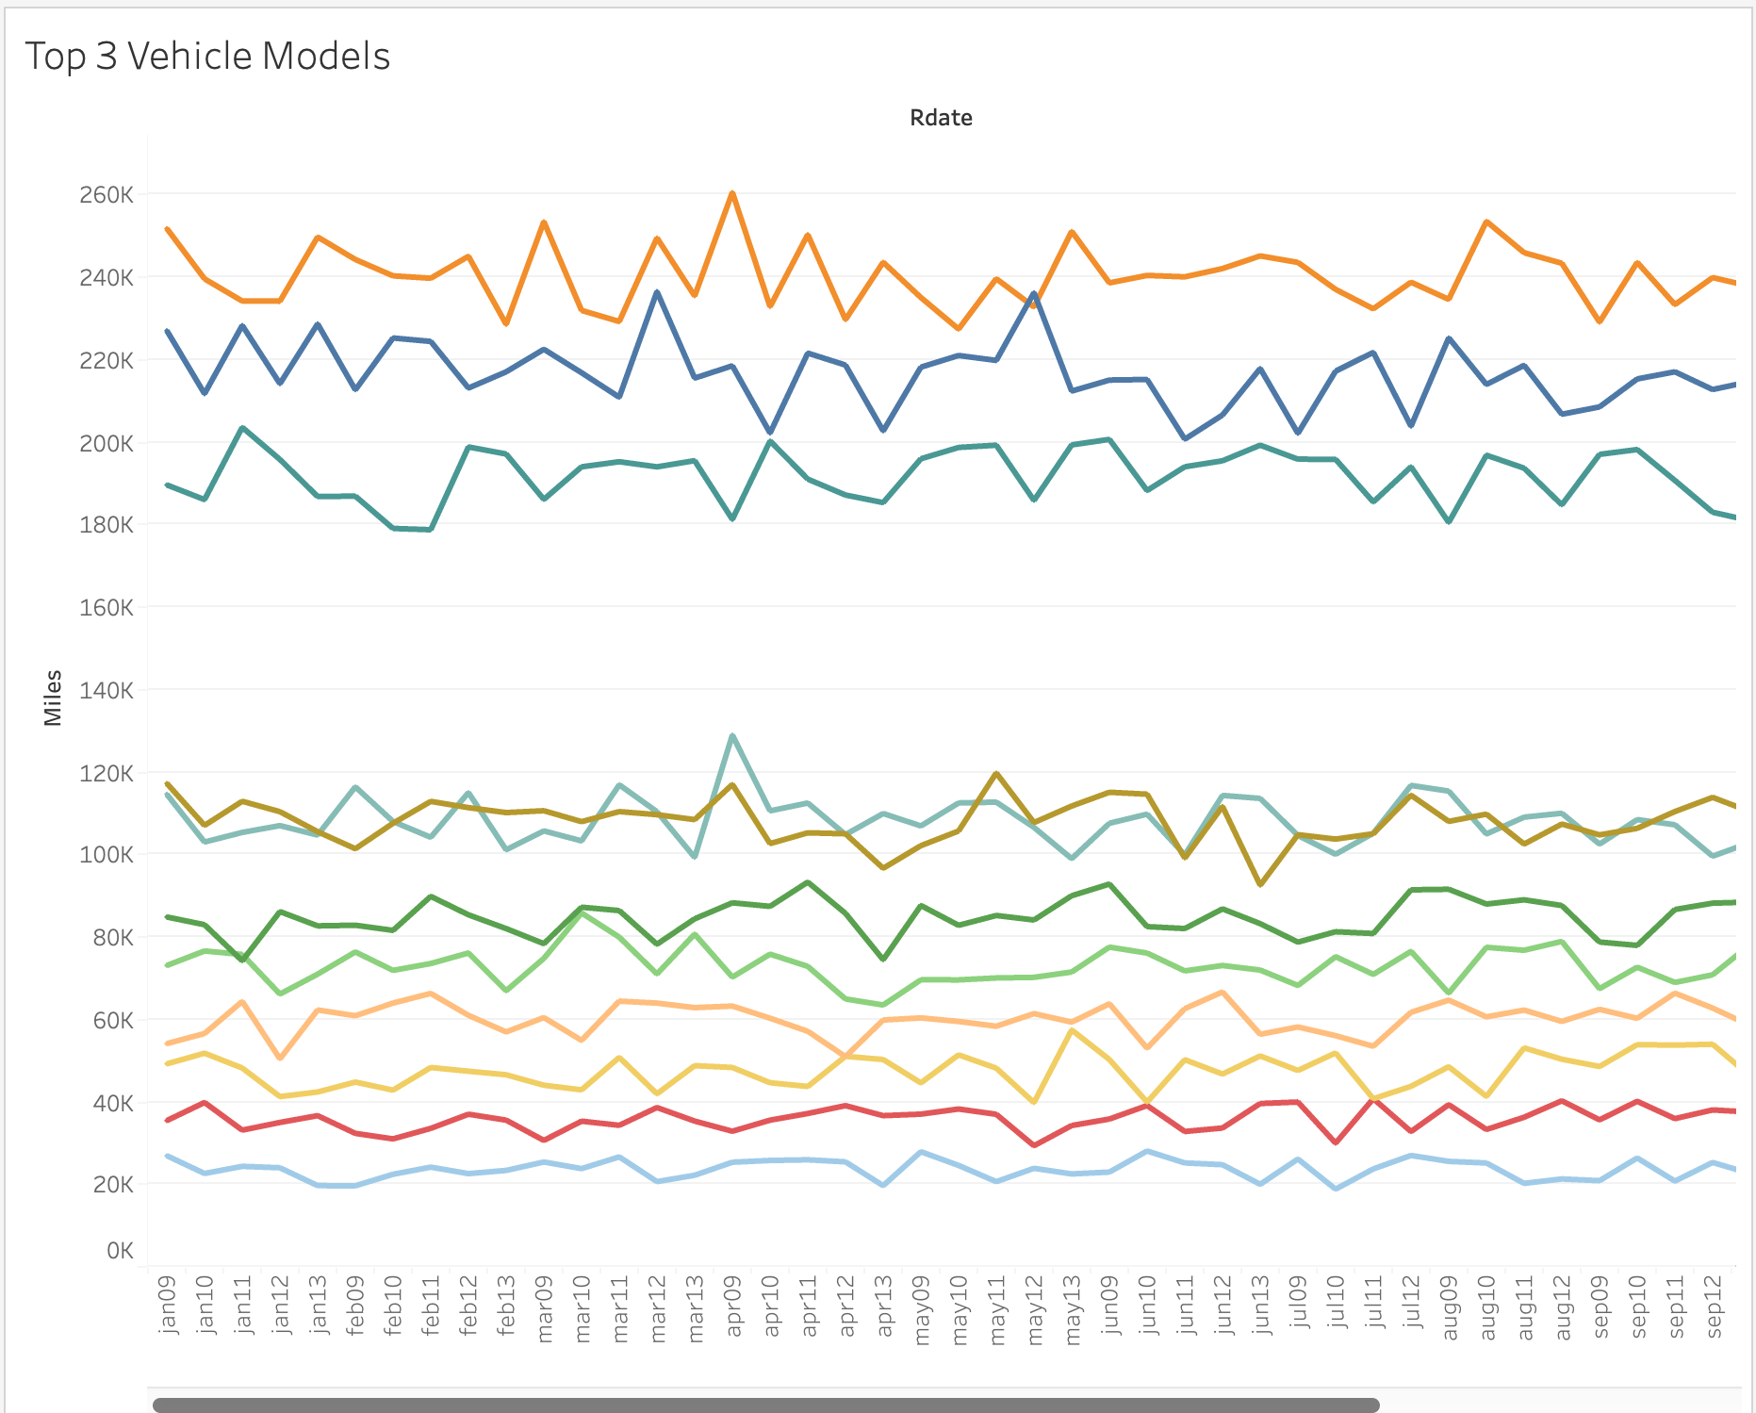
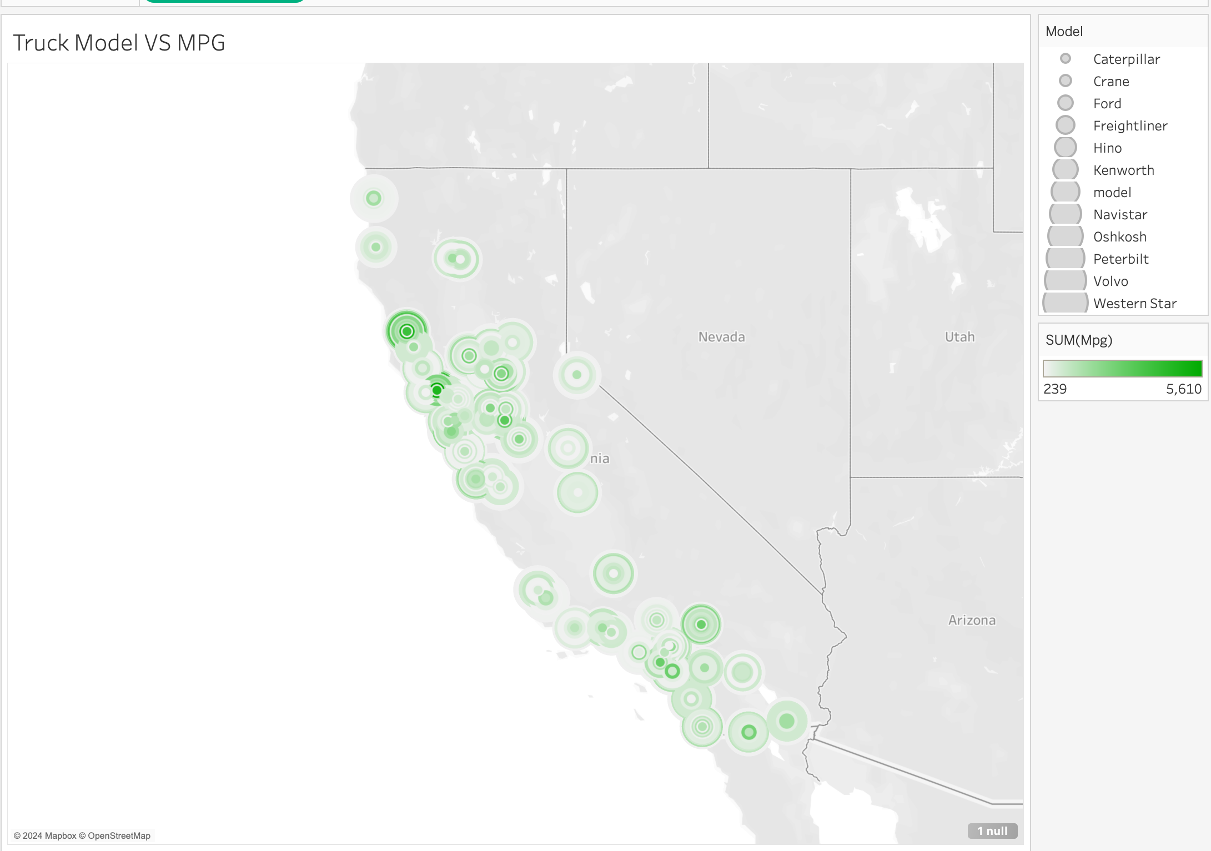
Analysis 3 TRUCK VS MPG
How can a truck manufacturer determine the most fuel-efficient model in its lineup by analyzing MPG data across different models?
*The model with the highest SUM(MPG) value, suggesting the total miles per gallon across all trucks of that model, would indicate better fuel efficiency.
*Identifying which model consistently shows higher miles driven with lower frequency of refueling events (implying higher MPG), across different periods and conditions.

Slide 10
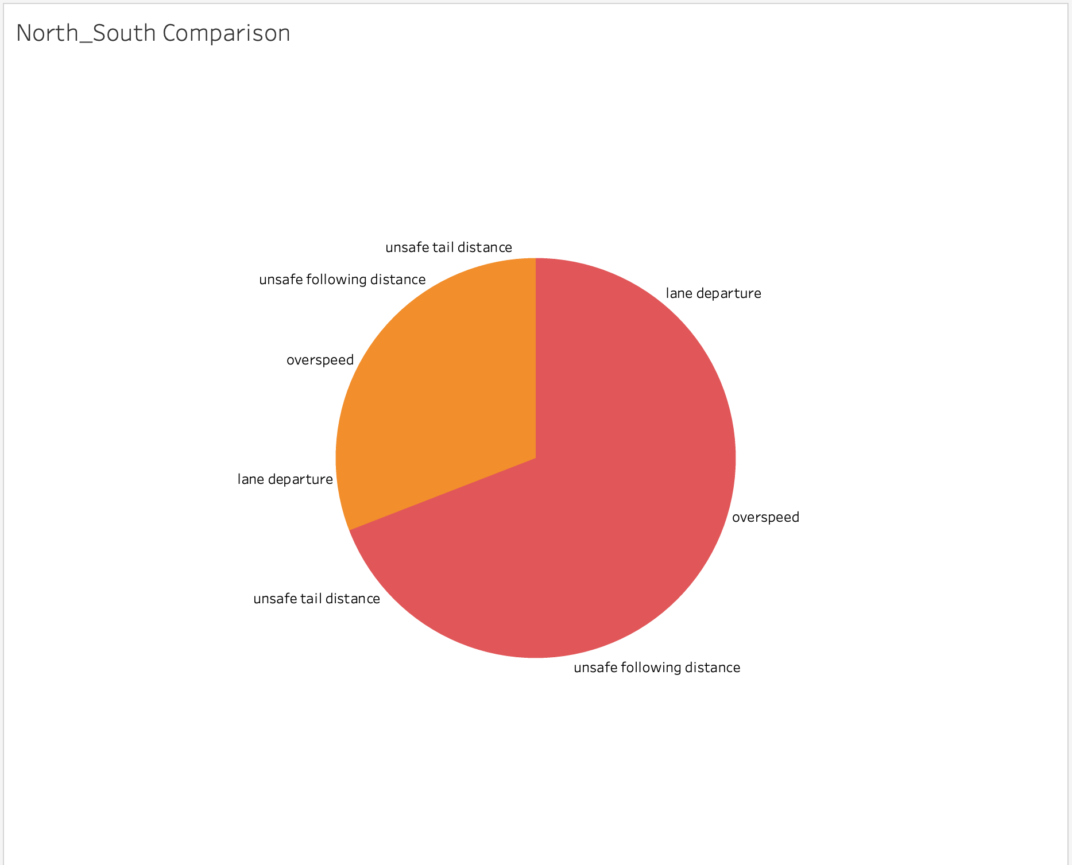
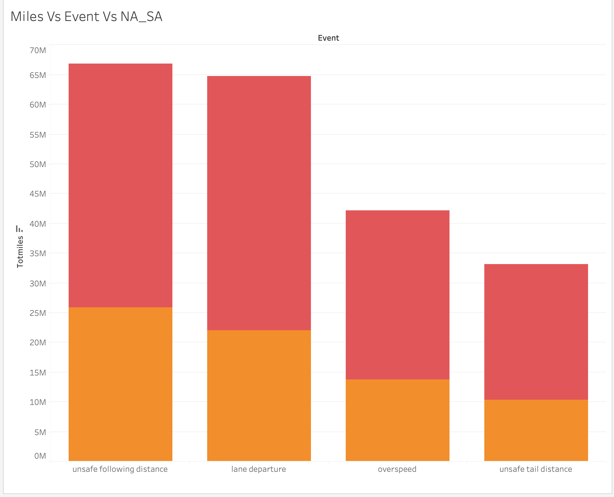
Analysis 4 – North vs South comparison
Are there more events occurring in one region than the other?
*Yes, North California is significantly riskier to drive in than South California.
*The event with the highest total miles driven, 'unsafe following distance', also has the highest frequency of occurrences.
*'Lane departure' events have a slightly lower total of miles driven compared to 'unsafe following distance' events yet.
*They are comparable in frequency, suggesting that lane departures are proportionally more frequent per mile driven than unsafe following distances

Slide 11
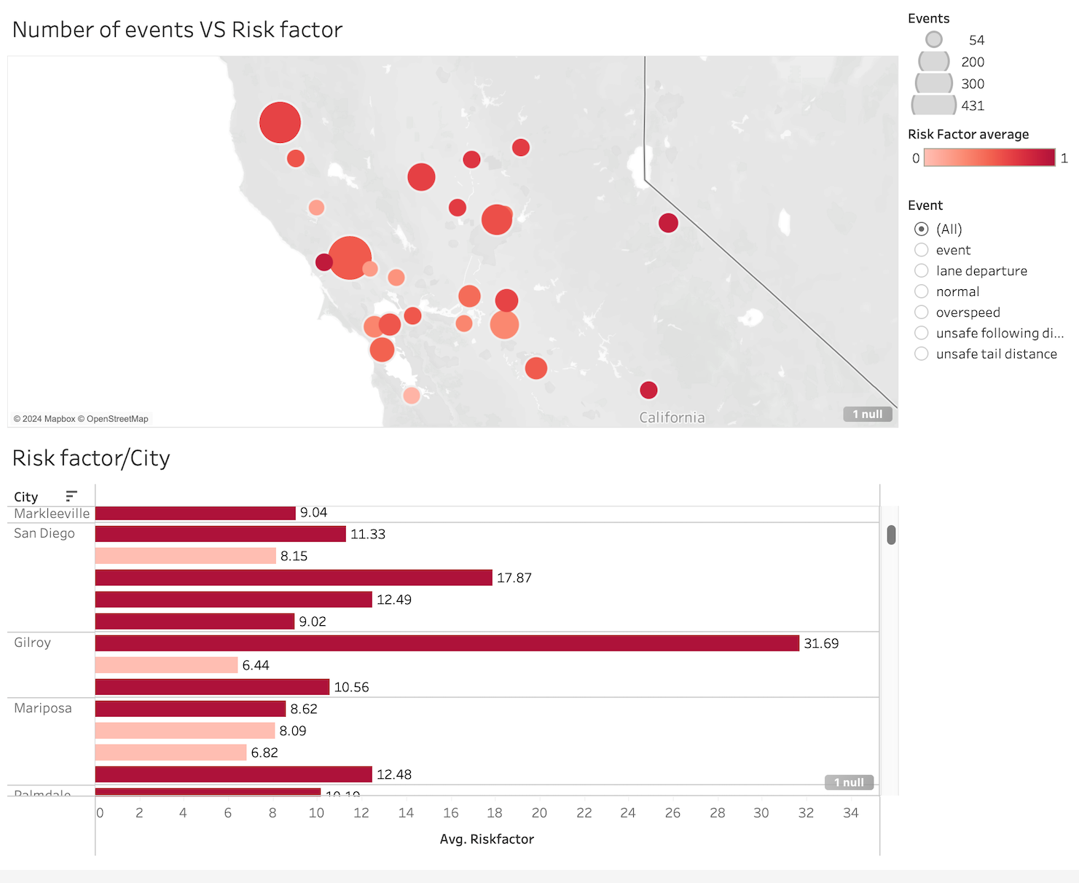
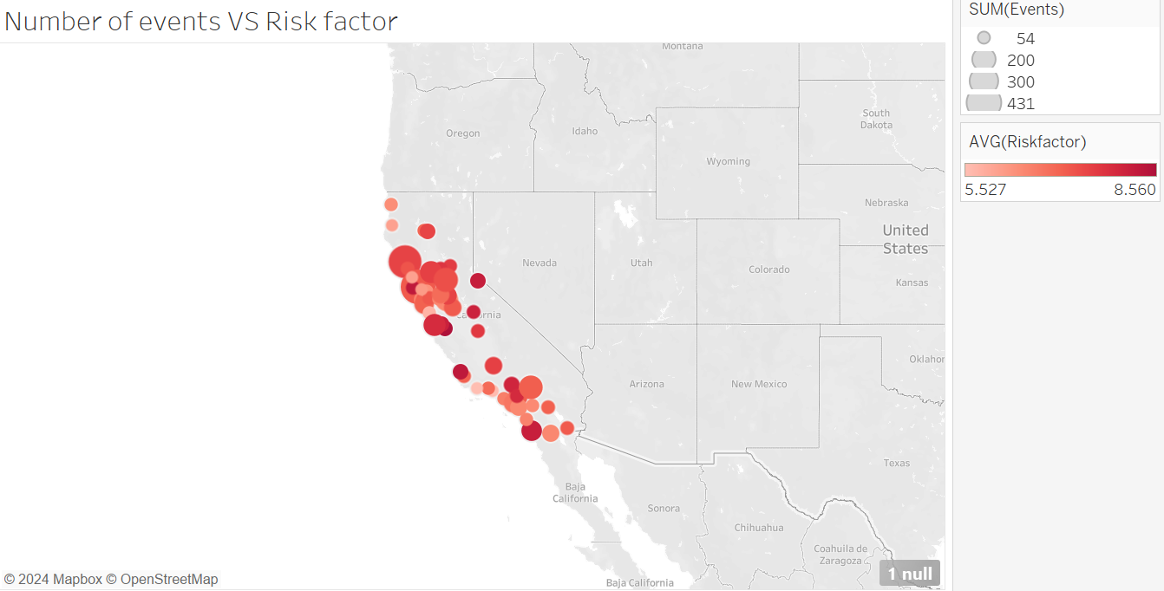
Analysis 5– Number of events vs risk factor
Which city has the highest risk factor, and which events occur above average in which city?
*The cities with the highest risk factor are Lodi and Gilroy, both with a risk factor of 31.69.
*All the light red bars in the graph have below-average risk. The ones with dark red bars have above-average risk factors. The average risk factor for all the cities in California is 7.5
*With sensor data, we can target all the events that occur more than average in the city to combat risky driving.

Slide 12
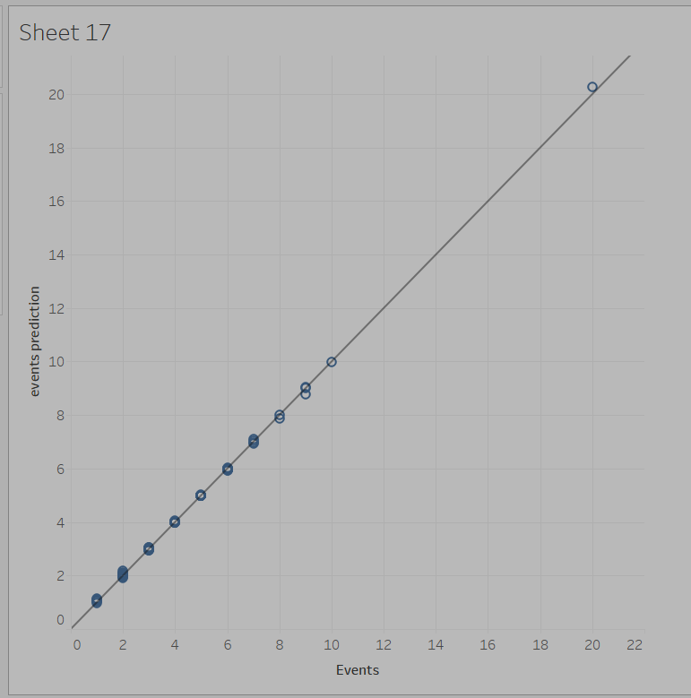
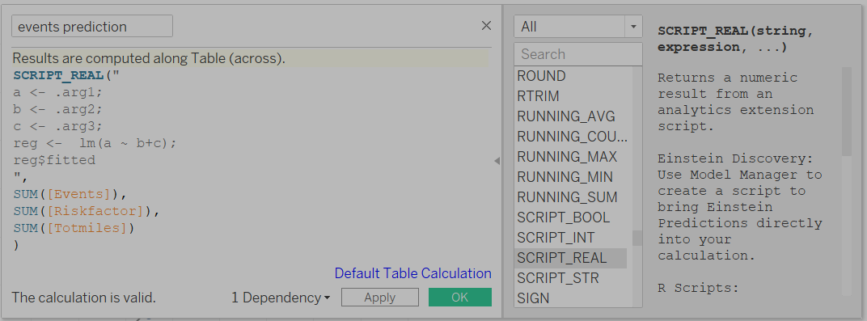
R Regression- Predicted Risk Linear relationship between predicted risk and events

Slide 13

Challenges
While doing regression, we were unable to uncheck aggregate measures.
Accidentally updated the VM so all the tables were lost, and we had to start from scratch.
Did not manage time properly, caused lots of issues with everything being done in the last moment.
Limited knowledge of Tableau.

Slide 14

Conclusion
It’s clear that being on the road a lot doesn’t always mean a driver is safe. Finding the sweet spot between experience and careful driving is key for the ideal driver profile.
Safety strategies need a local touch. Cities like Lodi and Gilroy with higher risk factors should get custom safety plans to tackle their unique challenges.
Checking out the MPG stats helps pinpoint which trucks are easier on the fuel. It's a smart move for a greener footprint and better savings on the go.

Slide 15

THANK YOU!

